Slide 1
An Agentic AI-Based Multi-Agent System for Network Intrusion Detection, Triage, and Adaptive Response
Presented by
1. P.Sri Sai Phani 245523753040
2. R. Hima Varshini 245523753044
3. V.S.S Madhuri 245523753051
Major Project Review1- 24 - Sep -2026
Under the Supervision of
Mrs. Gayithri Tippani
Assistant Professor, CSE(AI&ML)
Keshav Memorial Engineering College,Hyderabad

Slide 2
Contents

Slide 3
Introduction
The rapid growth of interconnected systems has increased the frequency and complexity of cyberattacks. Traditional Intrusion Detection Systems mainly detect threats using predefined rules or static models, but they often generate excessive alerts without providing adequate investigation or response support. This project proposes an Agentic AI-Based Multi-Agent System for Network Intrusion Detection, Triage, and Adaptive Response. It combines Machine Learning, Large Language Models, Retrieval-Augmented Generation, and specialized AI agents to detect suspicious network activity, investigate incidents, prioritize threats, recommend suitable responses, and verify their effectiveness. Human approval is included before sensitive actions, making the system safer, explainable, and suitable for practical cybersecurity applications.

Slide 4
Motivation
Rising volume and sophistication of cyberattacks
Alert fatigue and analyst overload
Lack of contextual reasoning in conventional NIDS
Fragmented detection-to-response pipeline
Potential of agentic AI and LLM-driven reasoning

Slide 5
Literature Survey
S.No | Year | Model | Parameters | Observations
1. Dual-Attention CNN-BiLSTM | 2026 | CNN-BiLSTM with FocusConv (local) + TempoNet (global) dual-attention modules | EQL v2 class-weighting for imbalance | Combines local and temporal feature focus; targets low detection rate of traditional models
2. Unified Generative & Explainable AI (CPS) | 2026 | GAN (for class imbalance) + SHAP/LIME/attention-based XAI | Industrial CPS, IIoT, smart-grid datasets | 97.4% accuracy, 96.1% F1, 3.1% false-alarm rate, 0.983 AUC, and 91.2% zero-day detection (vs 84.7% GAN-only and 78.6% XAI-only)
3. Agentra | 2026 | Multi-agent LLM IRS: Planner–Validator loop, Moderator gateway, Action Catalog | Grounded in MITRE ATT&CK, D3FEND, NIST CSF 2.0 | Converts alerts into structured plans; evaluated against a static OASIS CACAO playbook baseline on a 120-event corpus
4. CORTEX | 2025 | Multi-agent LLM: behavior-analysis, evidence-gathering, reasoning agents | Real SOC production-log dataset | Substantially reduces false positives and improves investigation quality over single-agent LLM baselines
5. CyberRAG | 2025 | Agentic RAG: central LLM orchestrator + attack-specific fine-tuned classifiers | SQLi, XSS, SSTI benchmarks | 94.92% overall accuracy; explanations scored 0.94 BERTScore, 4.9/5 in GPT-4 expert evaluation
6. eX-NIDS | 2025 | NIDS + LLM post-hoc explainer, two-stage prompting | Malicious NetFlows + CTI context | Two-stage prompting boosts explanation correctness from 40% to 80% with 100% feature consistency
7. Explainable DNN + SHAP | 2023 | DNN with SHAP (local + global explainability) | NSL-KDD, UNSW-NB15 | Achieved accuracy of 99.99% and 99.96% respectively; identifies top-4 features locally, top-20 globally
8. IRCOPILOT | 2025 | 4 collaborative LLM session components mimicking IR team phases | Incremental real-world IR benchmark | Sub-task completion rates of 150%, 138%, 136%, 119%, 114% vs baseline LLMs across tasks

Slide 6
Limitations
Limited dataset diversity – Most studies rely on a single or small set of benchmark datasets (e.g., CIC-IDS2017, NSL-KDD), reducing generalization to real-world traffic.
High computational cost – Deep or hybrid models (CNN‑BiLSTM, GAN‑based, multi‑agent) demand heavy resources, limiting deployment on edge or IoT devices.
Weak real‑time validation – Several frameworks report accuracy but omit latency or operational feasibility in live environments.
Restricted explainability scope – Many XAI integrations (SHAP, LIME) provide global insights but lack fine‑grained, case‑specific explanations for analysts.
Single‑dataset or lab‑only evaluation – Few papers test across heterogeneous or cross‑domain scenarios, leaving robustness underexplored.
Incomplete handling of data imbalance and zero‑day attacks – Techniques improve minority‑class recall but still struggle with unseen or evolving threats.
Limited integration with human workflows – Agentic or LLM‑based systems show promise but lack standardized evaluation of trustworthiness, supervision, and auditability.

Slide 7
Problem Statement
Traditional IDS rely on static signatures or rules, making them ineffective against unknown or evolving attack patterns.
Analysts face alert overload, receiving thousands of alerts without clear prioritization or actionable context.
Current systems lack explainability, leaving security teams uncertain about why an alert was triggered or how to respond.
Manual investigation and triage are slow and resource‑intensive, delaying containment and increasing risk.
Response workflows are fragmented and reactive, with no closed‑loop verification or adaptive learning from past incidents.

Slide 8
Objectives
1. To detect suspicious and malicious network activity using machine-learning models.
2. To develop specialized AI agents for monitoring, detection, diagnosis, threat prioritization, and response planning.
3. To use Retrieval-Augmented Generation (RAG) to retrieve relevant cybersecurity knowledge, response procedures, and previous incident information.
4. To recommend suitable response actions and obtain human approval before executing sensitive security operations.
5. To verify the effectiveness of the response and store resolved incidents for improving future threat investigations.

Slide 9
Proposed System
1. Network Data & ML Detection
Processes benchmark datasets such as NSL-KDD and CICIDS2017.
Network-flow features are pre-processed before classification.
Random Forest, XGBoost, and Isolation Forest are used for classification and anomaly detection.
ML performs the actual network traffic detection.
2. Multi-Agent Investigation
Monitoring Agent: Receives and validates network events.
Detection Agent: Executes ML models and produces attack prediction, category, confidence, and anomaly information.
Diagnosis Agent: Investigates suspicious events, analyzes evidence, and generates possible attack hypotheses.
Threat Intelligence & RAG Agent: Retrieves relevant cybersecurity knowledge.
Prioritization Agent: Determines risk, severity, and priority.
Response Agent: Generates and manages the response plan.
3. Intelligent Decision Support
LLM: Used for investigation, reasoning, explanation, and response planning.
RAG: Provides contextual cybersecurity knowledge.
LangGraph: Coordinates agents and conditional workflows.
Human-in-the-Loop: Required before high-impact response actions.

Slide 10
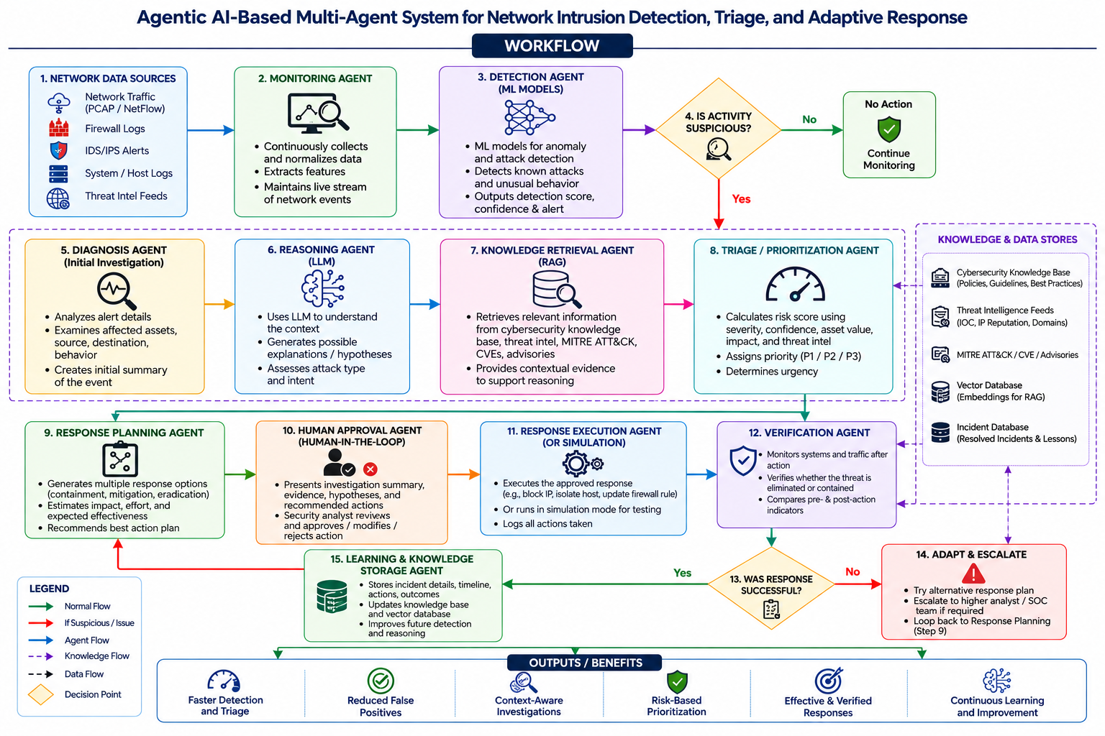
Proposed Architecture

Slide 11
References
A Dual-Attention CNN-BiLSTM Model for Network Intrusion Detection
A Unified Generative and Explainable Artificial Intelligence Framework for Trustworthy Intrusion Detection in Cyber-Physical Network
Agentra - A Supervisable Multi-Agent Framework for Enterprise Intrusion Response
CORTEX - Collaborative LLM Agents for High-Stakes Alert Triage
CyberRAG - An agentic RAG cyber attack classification and reporting tool
eX-NIDS - A Framework for Explainable Network Intrusion Detection
Explainable Deep Neural Network for a Reliable Intrusion Detection System with Shapley Additive Explanation Method
IRCOPILOT - Automated Incident Response with Large Language Models

